Slide 1
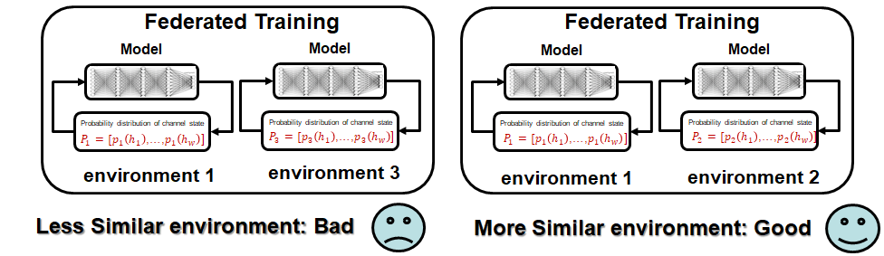
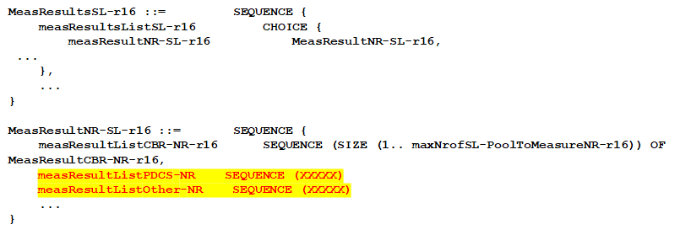
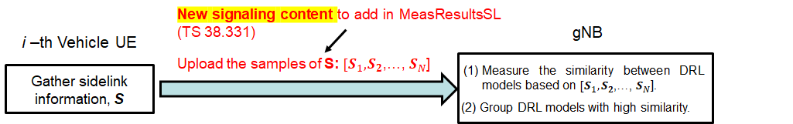
Federated Learning in V2X Communications for Side-link Enhancement
Problem： Different environment results in heterogeneity of dataset for device, leading to the degradation of FL performance
Standard Impact：
MeasResultsSL information element (TS 38.331)
Solution： UE selection & Grouping
Add new signaling “measResultListPDCS-NR” in MeasResultsSL to transmit the probability distribution of channel state P_i=[p_i (h_1 ),p_i (h_2 ),…,p_i (h_w )] in sidelink i, where is the probability that sidelink is in channel state
Add new signaling “measResultListOther-NR” in MeasResultsSL to transmit other sidelink information such as RSRP, RSRQ, RSSI, SNR, CSI, NLOS/LOS, channel statistics (e.g., mean, variance), etc
S is the sidelink information, which could be the channel busy ratio (already existed), RSRP, RSRQ, RSSI, SNR, CSI, NLOS/LOS), etc. We specifically add the probability distribution of channel state as the new content.
Measure of similarity: P_i=[p_i (h_1 ),p_i (h_2 ),…,p_i (h_w )]
Notes:
An electronic device, comprising: processing circuitry programmed to: send a coordination request signal to at least one candidate coordination device; determine at least one coordination device in accordance with a response from the at least one candidate coordination device; establish a coordination connection with the at least one determined coordination device; communicate target data through a plurality of communication links, the plurality of communication links comprising communication links between the electronic device and the at least one determined coordination device; send device parameter information to an external coordination control device; receive a candidate coordination device instruction determined by the external coordination control device; and send information of the at least one determined coordination device to the external coordination control device, wherein the device parameter information includes a position of the electronic device and/or information of the target data.

